Slide 1
Reversible Data Hiding In Encrypted Images By Reserving Room Before Encryption
Team Members-
Kamesh Phegde
Sonia Bhandi
Amritdas Vaishnav
Project Guide-
Prof S.P. Joshi

Slide 2
Contents
Sr.No | Contents
1 | Introduction
2 | Literature Survey
3 | Objective
4 | Future Scope
5 | Proposed System
6 | Use Case Diagram
7 | Methodologies/Techniques/Algorithms
8 | Implementation Plan

Slide 3
Contents
Sr.No | Contents
9 | Results
10 | References
11 | Conclusion

Slide 4
Introduction
Data Hiding is the process to hide data (representing some information) into cover media. That is, the data hiding process links two sets of data, a set of the embedded data and another set of the cover media data.
Reversible data hiding (RDH) approach in image processing is an innovative technique, where the information related to original cover recovered in lossless approach.
Reversible data hiding is always an interesting area of research for many researchers because of its excellent information recovering without any loss.

Slide 5
Literature survey
Paper | Authors, year | Technique Used | Advantages | Drawbacks
Reversible image watermarking using interpolation technique [1]L. Luo, Z. Chen, M. Chen, X. Zeng and Z. Xiong, "Reversible Image Watermarking Using Interpolation Technique," March 2010. | Lixin Luo, Zhenyong Chen, Ming Chen, Xiao Zeng, and Zhang Xiong .2010 | the interpolation-error, the difference between interpolation value and corresponding pixel value | Can achieve better image quality. Cost of computation is small | Any mistake in the calculation of interpolation will affect the secret information
“Separable reversible data hiding in encrypted image[2]X. Zhang, "Separable Reversible Data Hiding in Encrypted Image," April 2012. | X. Zhang, 2012 | image encryption,data embedding and dataextraction/image-recovery phases | Simple Less computation | Data compression is not efficient

Slide 6
Literature survey
Paper | Authors, year | Technique Used | Advantages | Drawbacks
Reversible Data Hiding in Encrypted Images by Reserving Room Before Encryption[4] K. Ma, W. Zhang, X. Zhao, N. Yu and F. Li, "Reversible Data Hiding in Encrypted Images by Reserving Room Before Encryption," March 2013 | Kede Ma, Weiming Zhang, Xianfeng Zhao, Member, IEEE, Nenghai Yu, and Fenghua Li | Traditional RDH method ,Histogram shifting. | achieve real reversibility, separate data extraction | Overflow/underflow occurs.
Improving various reversible data hiding schemes via optimal codes for binary covers[3] W. Zhang, B. Chen and N. Yu, "Improving Various Reversible Data Hiding Schemes Via Optimal Codes for Binary Covers," June 2012. | W. Zhang, B. Chen, and N. Yu2012 | Decompression algorithm as the coding scheme for embedding data. | proved to be optimal | problem is whether there exists other more effective modifying methods or not.

Slide 7
Objective
The proposed method can achieve real reversibility that is , data extraction and image recovery are free of any error.
Thus, the data hider can benefit from the extra space emptied out in previous stages to make data hiding process effortless.
Takes advantages of different techniques for plain images and achieve excellent performance without any loss of perfect secrecy

Slide 8
Future Scope
In Future for higher embedding capacity ,the specific encryption algorithm & specific decryption algorithm modules can be added to our system.

Slide 9
Proposed System
In our proposed system , we are going to use the below stated modules.
Modules
1. Encrypted image generation-In this module , to construct the encrypted image , the first stage can be divided into two steps:
a. Image partition – The goal of image partition here is to reserve room before encryption by using standard RDH technique.
b. Self reversible embedding- The goal of self reversible embedding is to embed the LSB-plains of image by employing traditional RDH algorithm.

Slide 10
Proposed system
3. Data hiding in Image-
Once the data hider acquires the encrypted image , we can embed some data into it , although we cannot get the access to the original image.
4. Data extraction and image recovery-
In this method if the recipient only has the encryption key, then the original image will be perfectly recovered .If the recipient only has the data–hiding key, then the secret data will be recovered . If the recipient has both the keys then the image and the secret data both can be available.

Slide 11
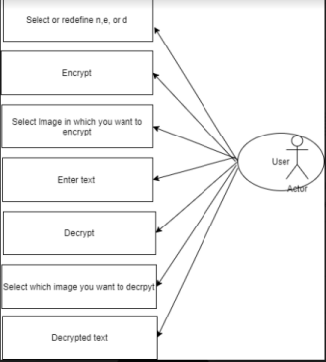
Use Case Diagram

Slide 12
Methodology/Techniques/Algorithms
Text is encrypted using RSA algorithm.
For the secret data hiding, the simple method LSB replacement is used.

Slide 13
Methodology/Techniques/Algorithms
A. RSA Algorithm –
RSA stands for Rivest–Shamir–Adleman, is an algorithm used by modern computers for encryption and decryption of file/text. It is an asymmetric cryptographic algorithm.
Steps-
1.Pick two large prime numbers p and q, such that p isn't equal to q;
2. Calculate n = p*q;
3. Calculate phi(n) = (p-1) (q-1);
4. Pick e, in order that gcd(e, phi(n) ) = 1, 1 < e < phi(n);
5. Calculate d, in order that d*e mod phi(n) = 1, i.e. d is that the reciprocal of e in mod phi(n);
6 .Get public key as Ke= {e, n}; 7. Get private key as Kd= {d, n};

Slide 14
Methodology/Techniques/Algorithms
B. LSB Replacement Algorithm-
In this algorithm embed the each bit of the data in the least significant bits places of the original image.
Steps-
1.The embedding of the data is performed choosing a subset of image pixels and substituting the least significant bit of each of the chosen pixels with embedding bits.
2.The extraction of the data is performed by extracting the least significant bit of each of the selected image pixels.
3. If the extracted bits match the inserted bits, then the stored is detected. The extracted bits do not have to exactly match with the inserted bits.
4. A correlation measure of both bit vectors can be calculated. If the correlation of extracted bits and inserted bits is above a certain threshold, then the extraction algorithm can decide that the data is detected.

Slide 15
Details of Implemented Modules
Modules under Proposed System are:
Image Partition:
LSB algorithm is applied to empty the room for hiding the encrypted data.
Data hiding in Image :
We can embed some data into it , without affecting the original image.
Data extraction and image recovery :
The data can be recovered from the image without the loss of the quality of image.

Slide 16
Software/Hardware Requirements
Software and Hardware Requirements:
1.Software – Sublime text editor.Python
2.Hardware – Computer/Laptop
3.Mechanism– Front end and Back end development with database and API

Slide 17
Implementation plan
The user can browse the image from the files.After browsing of the image,the user can redefine the value of n , e, and d or they can go with the default value.After selection of n ,d, and e the user will be prompted to enter the text and it will be converted into Ciphertext.The blocks of cipher text will be printed.This is the process of encryption.
For the process of Decryption the user can select the image which he or she wants to decrypt and with the help of RSA algorithm the cipher text is decrypted and the text hidden is retrived

Slide 18
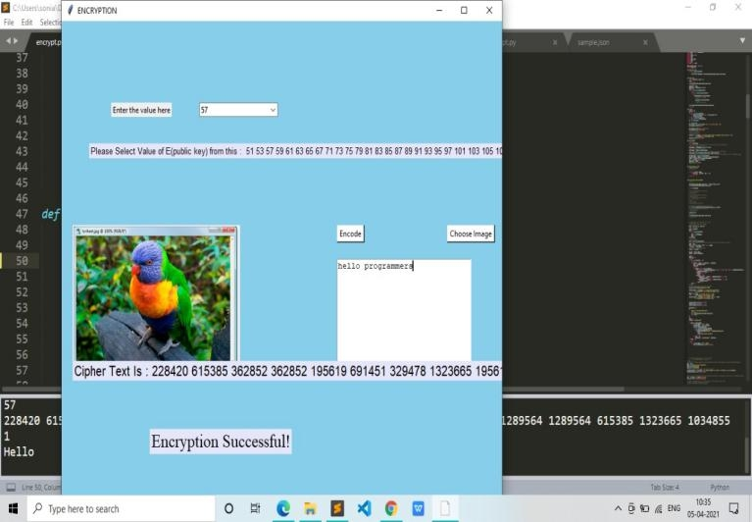
Results

Slide 19

Result

Slide 20
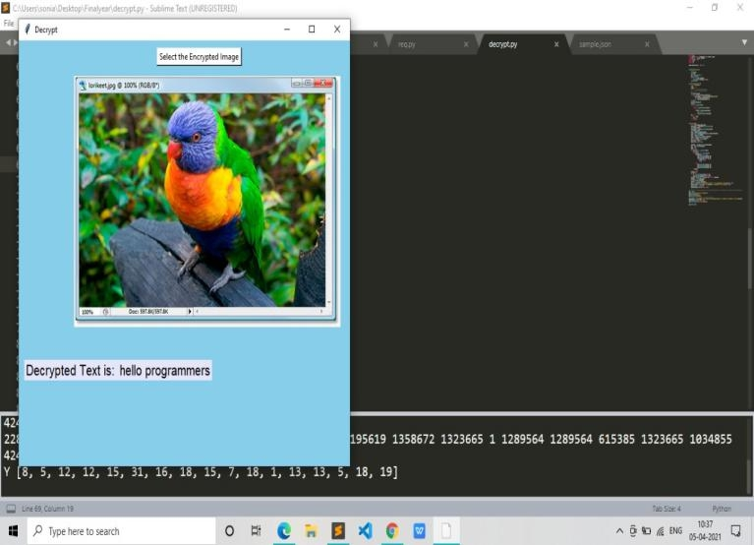
Result

Slide 21
Results
Now we can search and insert an image.
The sender can easily trasfer the files using File Transfer protocol to the reciever. The Reciever will only get the decrypt file , and without knowledge of encryption process , it also provides security.
Our future implementation is to store the credentials in an online database server , through which the ease of access and redefinition of public as well as private keys can be done easily.

Slide 22
References
[1 ] L. Luo, Z. Chen, M. Chen, X. Zeng and Z. Xiong, "Reversible Image Watermarking Using Interpolation Technique," in IEEE Transactions on Information Forensics and Security, vol. 5, no. 1, pp. 187-193, March 2010.
[2] X. Zhang, "Separable Reversible Data Hiding in Encrypted Image," in IEEE Transactions on Information Forensics and Security, vol. 7, no. 2, pp. 826-832, April 2012.
[3] W. Zhang, B. Chen and N. Yu, "Improving Various Reversible Data Hiding Schemes Via Optimal Codes for Binary Covers," in IEEE Transactions on Image Processing, vol. 21, no. 6, pp. 2991-3003, June 2012.
[4] K. Ma, W. Zhang, X. Zhao, N. Yu and F. Li, "Reversible Data Hiding in Encrypted Images by Reserving Room Before Encryption," in IEEE Transactions on Information Forensics and Security, vol. 8, no. 3, pp. 553-562, March 2013

Slide 23
Conclusion
As the result,the original quality is not detoriated unlike in the existing system.
The sender and the receiver are able to obtain the image with same resolution and quality.

